Slide 1
Purposeful Writing
Purpose is the goal or aim of a piece of writing: to express oneself, to provide information, to persuade, or to create a literary work. There are four purposes writers use for writing

Slide 2
To Express
Expressive Writing –
It is used to “express”
our opinions
Email, Facebook, Twitter, blogs or other social networking sites.
The purpose of author's communication is to define the idea, process or any opinion that he/she wants to share with the readers.
Its main purpose is to make connections to others and to contribute to human thought and culture and to establish and deepen human contacts.

Slide 3
To Inform
Informative Writing –
It is used to educate or explain something to the audience • Essays • Research papers • Presentations.
This type of writing is clear, accurate, organized, thorough and above all fair.

Slide 4
To Persuade
Persuasive Writing –
a more serious form of writing on a debatable topic • Essay • Research paper • Presentations
The writer’s goal is to change the minds of the readers or at least to get the readers to question their position on a debate and consider the writer's point of view.

Slide 5
To Literate
Literary Work –
a form of creative writing as in fiction or nonfiction.
Novels • Plays • Poems
A form of writing that is not a composition style writing, but with the purpose to entertain more than inform.

Slide 6
Purpose in presentation
First, choose your purpose to write presentation as: to inform, to entertain, to persuade, to motivate etc..
Now understand your audience and find out their needs and wants.
Write your goals that you want to accomplish
Relate your goals with the audience’ goals and then focus on that.

Slide 7
Purpose statement
The purpose statement serves two important roles. It helps keep you focused and on track as you develop the presentation. It also helps your audience focused on your message from the get-go.
Here are a couple of examples:
“The purpose of my presentation is to inform you of the new changes in our contract.”
“My purpose today is to introduce the preliminary findings of our report.”

Slide 8
How to write
State your specific purpose in a sentence that includes the general purpose, a description of the intended audience, and a prepositional phrase summarizing the topic.
When creating a specific purpose for your speech, first, consider your audience. Second, consider the rhetorical situation.

Slide 9
What is a good purpose statement
To be effective, a statement of purpose should be: Specific and precise - not general, broad or obscure. Concise - one or two sentences. Clear - not vague, ambiguous or confusing.

Slide 10
Present with a purpose
The presenter should start the presentation with clear and concise purpose statement.
The purpose statement serves two important roles:
It helps keep the presenters focused and on track as they develop the presentation.
It also helps the audience focused on their message from the get-go.
Here are a couple of examples:
“The purpose of my presentation is to inform you of the new changes in our contract.”
“My purpose today is to introduce the preliminary findings of our report.”
“Today I will show you the 5 benefits of our new venture.”

Slide 11
Structure of the Presentation
Just like other forms of academic writing, a presentation can be divided into three parts:
an introduction detailing the purpose and structure of the talk;
a body covering the main points;
and a conclusion summarizing and highlighting the significance of your talk.

Slide 12
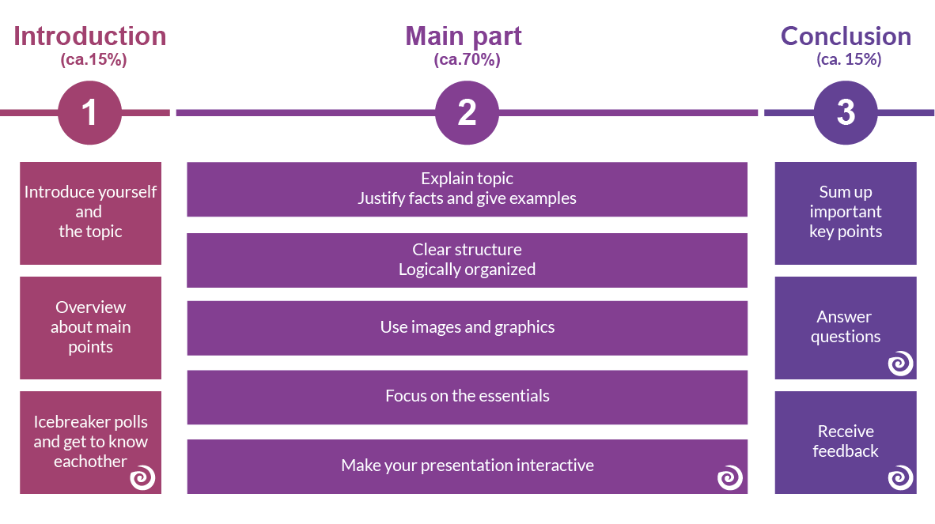

Slide 13
Task
Write four attractive purpose statements by considering four general purposes of presentation.
To express
To inform
To literate
To persuade

